Slide 1
Corridor Group Solution

Slide 2
Processing Steps
Load Data To Staging
Transform Into Agency Medical Record
Sync With SalesForce

Slide 3
Processing Steps
Load Data To Staging
Find Excel Files
Objective is to store all Agency-submitted raw data in its original state.
Each record is associated to its source file
Each file is archived for future reference and/or reprocessing
Audit and traceability to the source file and Excel row.
Assign Agency Based On Source File Path
Load All Records Staging Table
dbo.agency_file_row

Slide 4
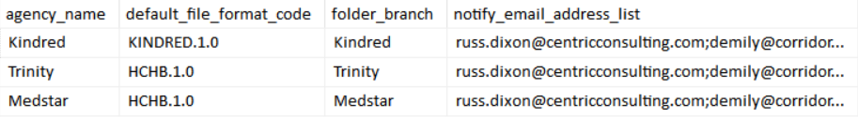
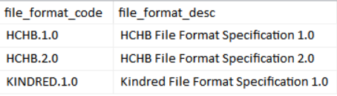
Solution Data
Master table for agencies.
dbo.agency
Master table for file formats.
dbo.file_format

Slide 5
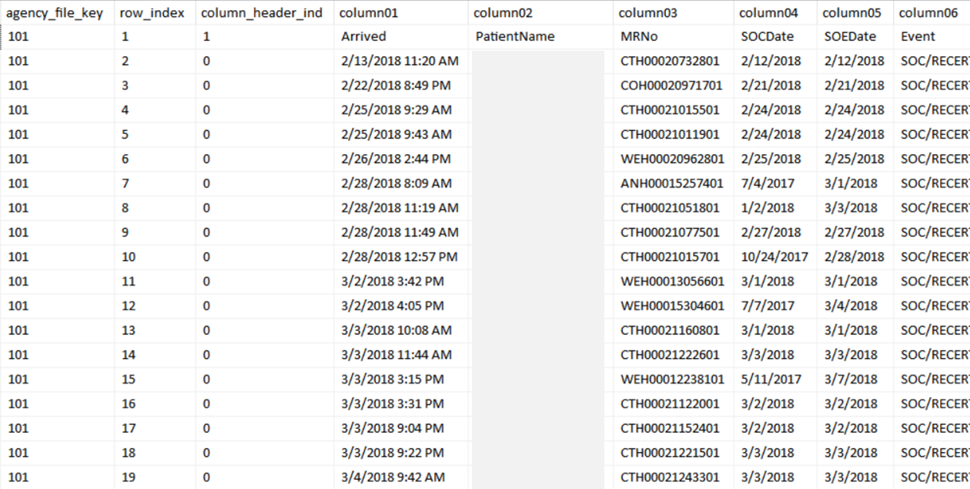
Solution Data
Record of every agency file processed
dbo.agency_file
Staging table for raw agency data
dbo.agency_file_row

Slide 6
Processing Steps
Transform Into Agency Medical Record
Derive Attributes from Staging Column Data
Loads each staging record into the Agency Medical Record
Maintains data integrity of Agency Medical records.
Apply transformations (filtering and text parsing)
Logs staging record transformation errors so they can be addressed.
Apply Attribute Transformations Where Applicable
Load Into Agency Medical Record
dbo.agency_medical_record

Slide 7
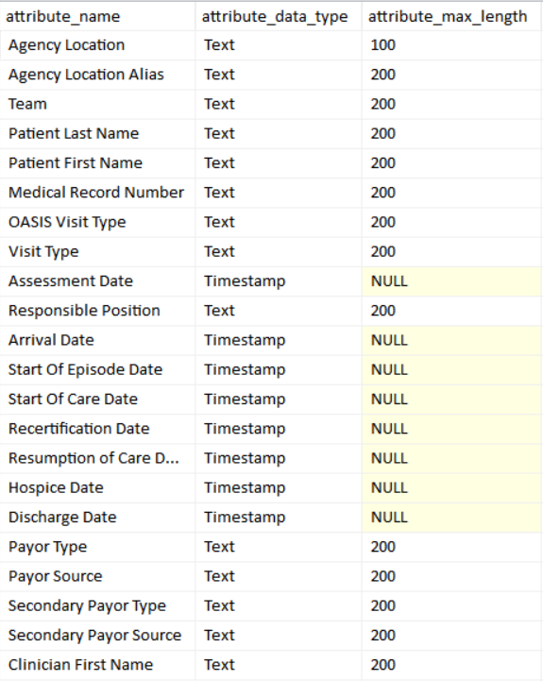
Solution Data
Master table for agency attributes.
dbo.attribute

Slide 8
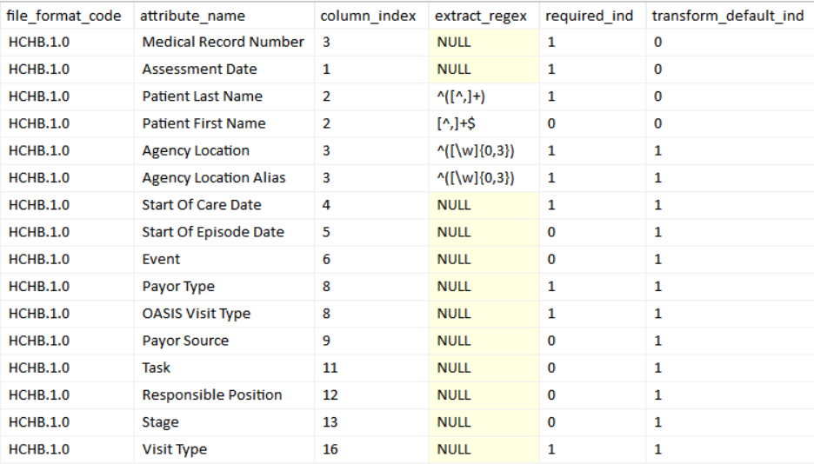
Solution Data
File format attribute transformation rules
dbo.file_format_attribute

Slide 9
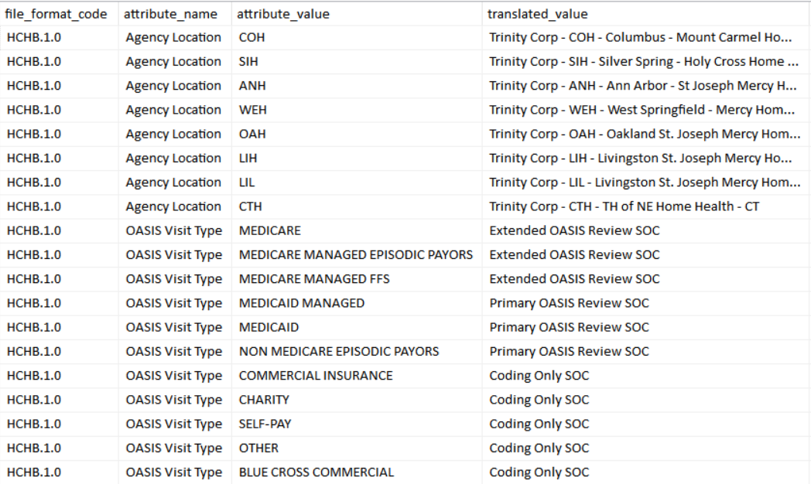
Solution Data
File format attribute value translation rules
dbo.file_format_translate

Slide 10
Processing Steps
Sync With SalesForce
Download Reference Data From Sales Force (Periodically)
Periodically pull updated reference data from SalesForce into local tables (daily, weekly?)
Apply filter rules to exclude record from Sync into SalesForce
Upload Agency Medical Record data to SalesForce
Log SalesForce process errors and other scenarios that prevent data uploading.
Filter Agency Medical Records To By Synced
Apply Sync To SalesForce
DM_Submission__c

Slide 11
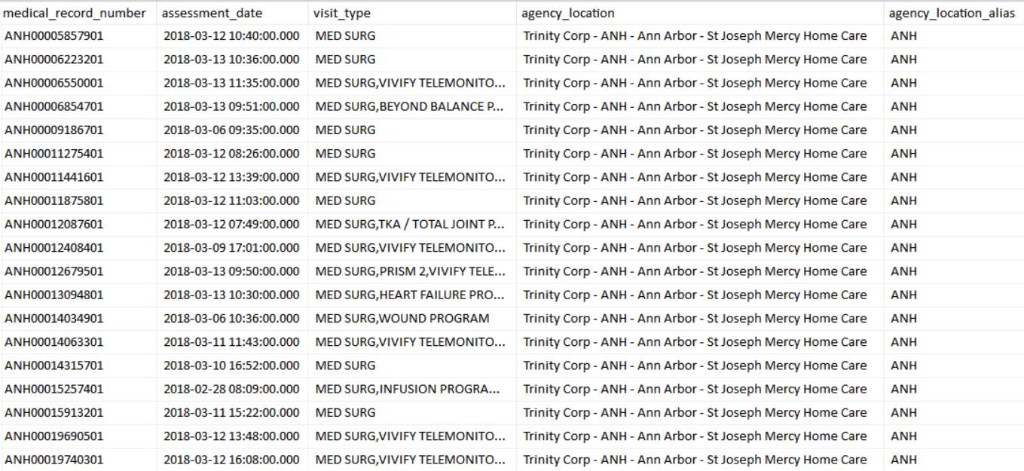
Solution Data
Fully transformed agency medical records
dbo.agency_medical_record

